Slide 1
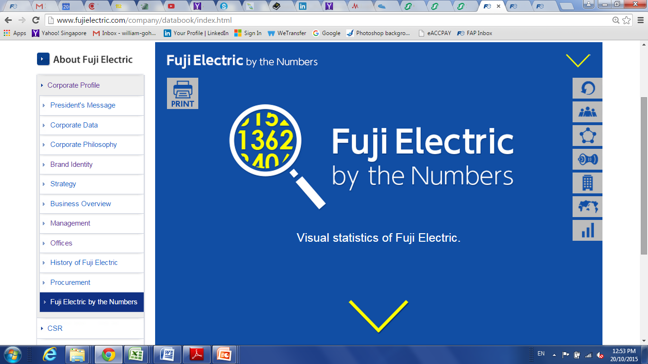

INTRODUCE THE NEW RANGE OF
LOW VOLTAGE
INVERTER
FAP- WG-eHVAC-Jan-2016
Notes:
Fuji Electric the pioneer in industry to develop general-purpose inverter since 1976 launches a new generation VSD.
The VSD is design to fit the ever changing demand of HVAC industries.

Slide 2

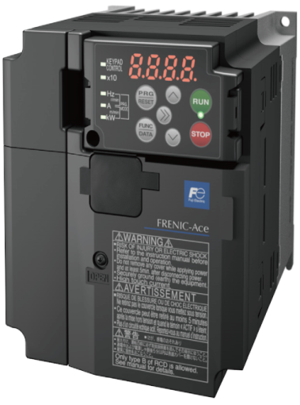

The new economy inverter that helps you cost down …
Simply Easy!
FAP- WG-eHVAC-Jan-2016

Slide 3

STANDARD BUILT
Voltage Range
Three-phase 380 to 480V，50/60Hz
Standard type (EMC filter built-in type)
0.75kW to 280kW
EMC Directives
EN 61800-3-2 : Emission: Category C2/C3. Immunity: 2nd Env.
Harmonic suppression
DC Reactor (Optional item, external mount) , 75kW & above must apply DCR
Overload Capability
120% for 1 minute
Protective structure
0.75kW to 30kW – IP20
37kW to 280kW – IP00
FAP- WG-eHVAC-Jan-2016

Slide 4
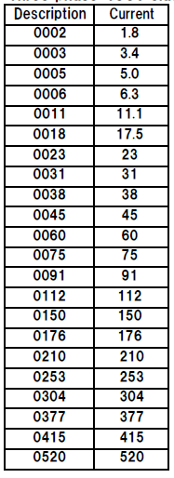
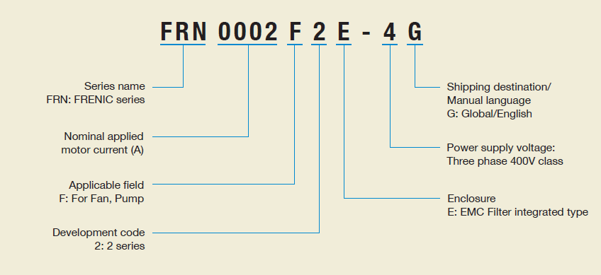
FAP- WG-eHVAC-Jan-2016

Slide 5
Capacity Range
Nominal applied motor[kW] | Model | EMC category
0.75 | FRN0002F2E-4G | Emission: Category C2/ Immunity:2nd Env
1.1 | FRN0003F2E-4G
2.2 | FRN0005F2E-4G
3.0 | FRN0006F2E-4G
5.5 | FRN0011F2E-4G
7.5 | FRN0018F2E-4G | Emission: Category C3/ Immunity:2nd Env
11 | FRN0023F2E-4G
15 | FRN0031F2E-4G
18.5 | FRN0038F2E-4G
22 | FRN0045F2E-4G
30 | FRN0060F2E-4G
37 | FRN0075F2E-4G
45 | FRN0091F2E-4G
55 | FRN0112F2E-4G
75 | FRN0150F2E-4G
90 | FRN0176F2E-4G
110 | FRN0210F2E-4G
132 | FRN0253F2E-4G
160 | FRN0304F2E-4G
200 | FRN0377F2E-4G
220 | FRN0415F2E-4G
280 | FRN0520F2E-4G
FAP- WG-eHVAC-Jan-2016

Slide 6
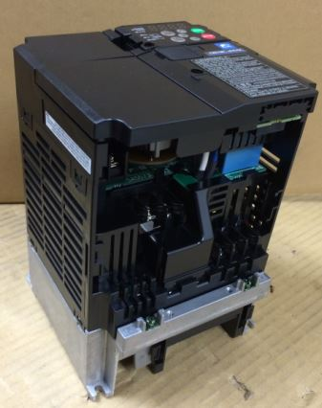
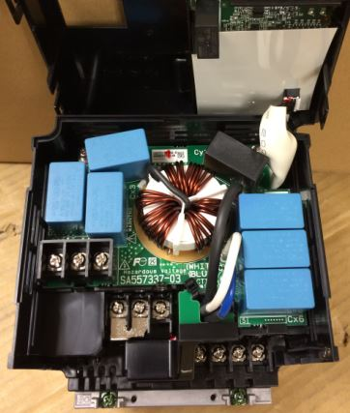
EMC Filter Built-in (integrated)
Integrated EMC Filter
0.75kw ~ 5.5kW IP20
FAP- WG-eHVAC-Jan-2016

Slide 7
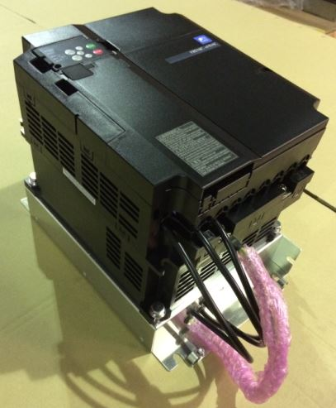
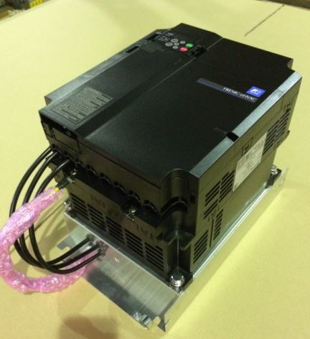
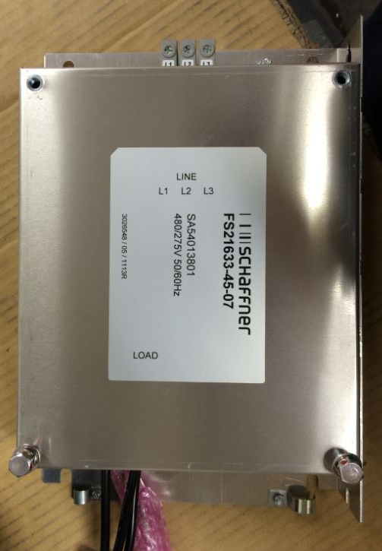
EMC Filter Built-in (foot-mount type)
Foot-mount EMC Filter
7.5kw ~ 18.5kW IP20
FAP- WG-eHVAC-Jan-2016

Slide 8
QUICK VIEW
Optimise Energy Saving
Automatic energy-saving operation.
Temperature difference constant control and pressure difference constant control. (Logic)
Auto-restart after momentary power failure Operation is continued using the load inertia energy.
Optimise Functions
Fire mode (forced operation)
PID control
Pick-up operation (catch on the fly)
Enable PM motor drive with PM Sensorless vector control
Vector control ???
Customized logic
Password function
FAP- WG-eHVAC-Jan-2016

Slide 9

Optimise Energy Saving
Automatic energy-saving operation.
- The output voltage is controlled to minimize the total power loss of the motor and
the inverter at a constant speed.
FAP- WG-eHVAC-Jan-2016

Slide 10
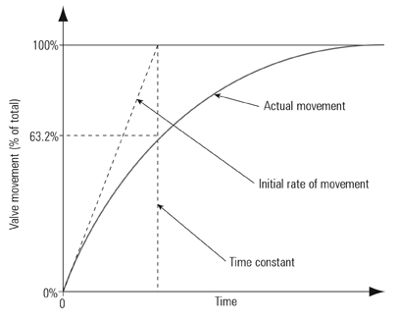
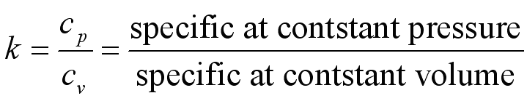
Optimise Energy Saving
Temperature difference constant control [* RTD option [OPC-PT] needed ]
and pressure difference constant control [Customised Logic Program]

Slide 11
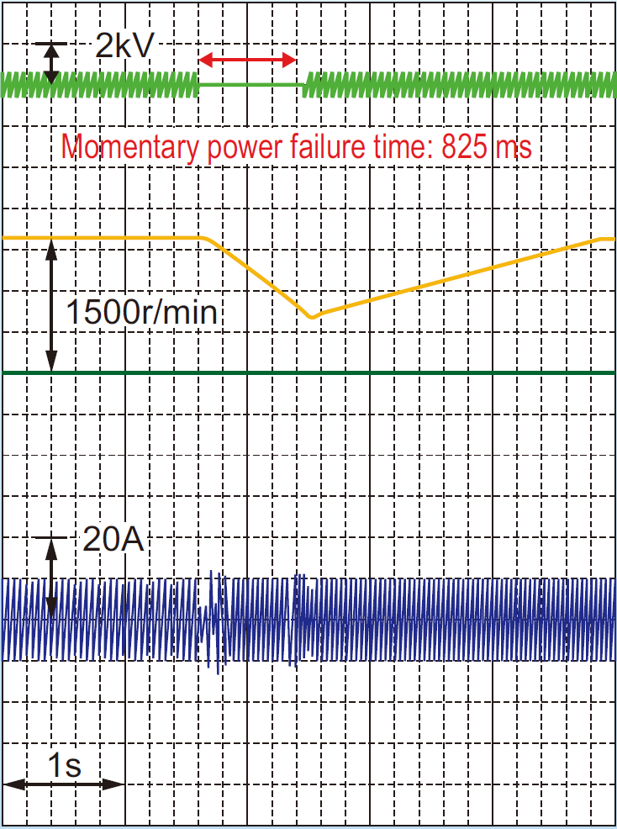
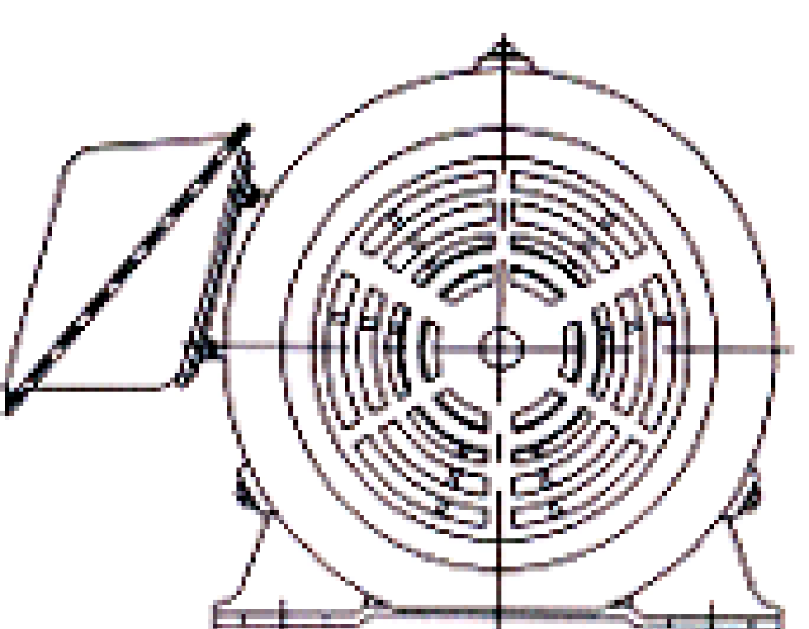
Optimise Energy Saving
Auto-restart after momentary power failure Operation is continued using
the load inertia energy.
Power
Supply
Voltage
Auto-Restart!
Motor
Speed
Output
current
Motor

Slide 12

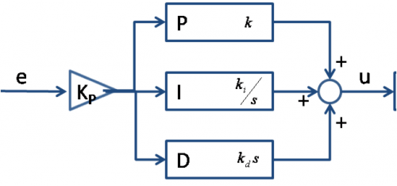
Optimise Functions
Fire Mode (Forced Operation)
Continues operation without alarm by retry in the event of fire.
PID Control (1 internal, 1 external)
Normal operation/inverse operation.
Multi-step setting(Selectable from 3 points)
PID feedback value
Alarm output (absolute value alarm, deviation alarm)
Slow Flowrate stop function
Anti-reset wind-up function
PID output limiter
Integration reset/hold
Proportional–Integral–Derivative

Slide 13
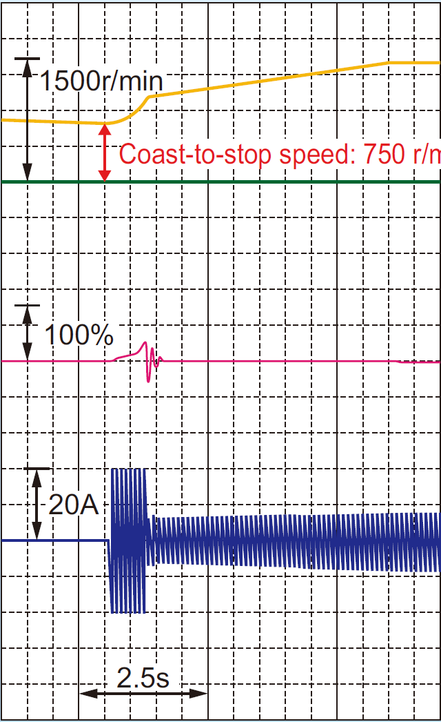
Optimise Functions
Pick-up operation (catch on the fly)
from free wheeling → catch on fly!
Motor
Speed
Torque
Output
current
Motor
FAP- WG-eHVAC-Jan-2016

Slide 14
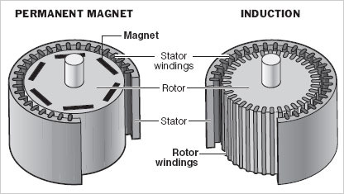
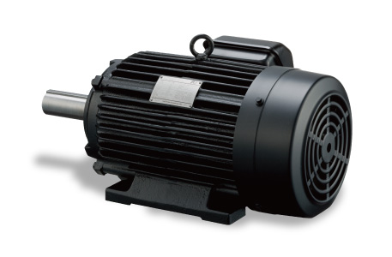
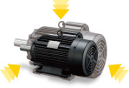
Optimise Functions
Enable PM (Permanent Magnet ) motor drive with PM Sensorless vector control.
Higher Efficiency (IE3，IEC 60034-30 Standard)
Lower Heat Loss
- Smaller Motor Fame Size
Fuji Electric PM Motor
(GNB2 Series)
Higher efficiency,
Smaller motor fame size
FAP- WG-eHVAC-Jan-2016

Slide 15

Optimise Functions
Vector Control
-Estimated speed under vector control without speed sensor.
Sensor
Output Current Detection calculation
FAP- WG-eHVAC-Jan-2016

Slide 16
Optimise Functions
Customized logic
Equipped with customized logic as standard to facilitate the free programming of up to 200 steps.
- Unique functions tailored to the application or usage method can constructed.
Logic circuit:
(Digital) AND, OR, XOR, flip-flops, rising/falling edge detection, counters, etc.
(Analog) Addition, subtraction, multiplication, division, limiter, absolute value, sign inversion
addition, comparison, highest selection, lowest selection, average value, measure conversion .
Multifunctional timer:
On-delay, off-delay, pulse train, etc. (Setting range: 0.0 to 9990 second)
Input/output signal:
Terminal input/output(Digital and Analog), logic circuit output, inverter command/monitor data.
The 200 steps are available. Output/input of each step can be connected.
FAP- WG-eHVAC-Jan-2016

Slide 17
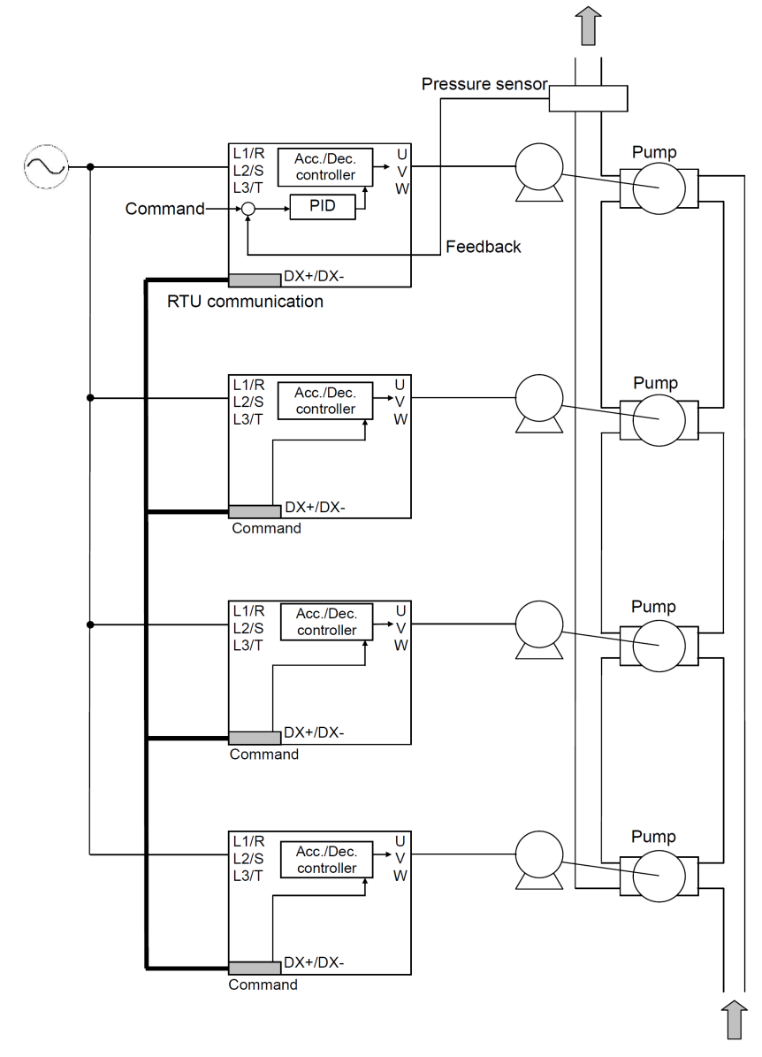
Optimise Functions
Mutual Operation
The system can be configured without using a controller
by connecting the inverter via communications.
In this system, if failure occurs to the master inverter, the
Next inverter is driven as the master inverter.
Moreover, wiring can be saved with use of communications
services, which eliminates the need of additional options by
using the Modbus RTU communications.
Normal
Master
Slave
Slave
Maximum link
up to 4 unit
Mutual Operation
Master
Master on duty
Slave
Slave
Quick and easy redundancy!
FAP- WG-eHVAC-Jan-2016

Slide 18
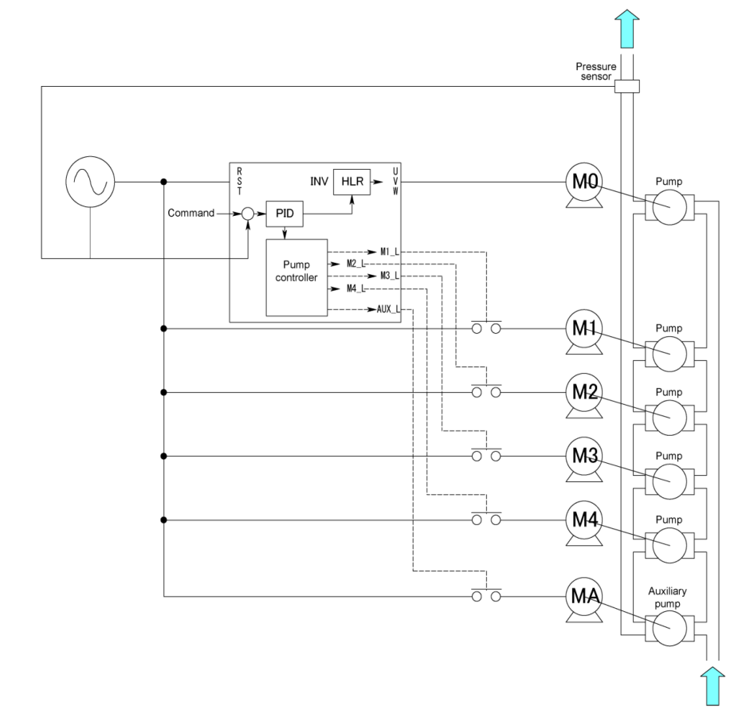
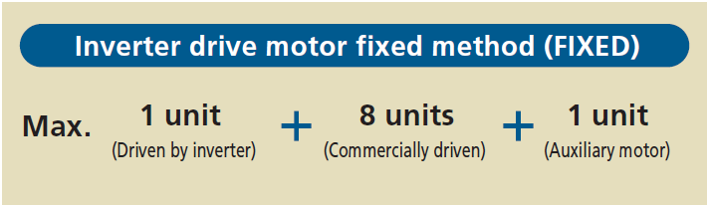
Optimise Functions
Cascade Control (Fixed)
The system is configured by combining the motor driven by the
inverter (M0), motor that are commercially driven (M1 to M4) and
auxiliary motor (MA).
Motors commercially driven are added one by one in control
When the required discharge flow rate cannot be achieved with
the motor M0 only.
Variable
4
A single FRENIC-eHVAC drives a maximum of 5 pump motors.

Slide 19
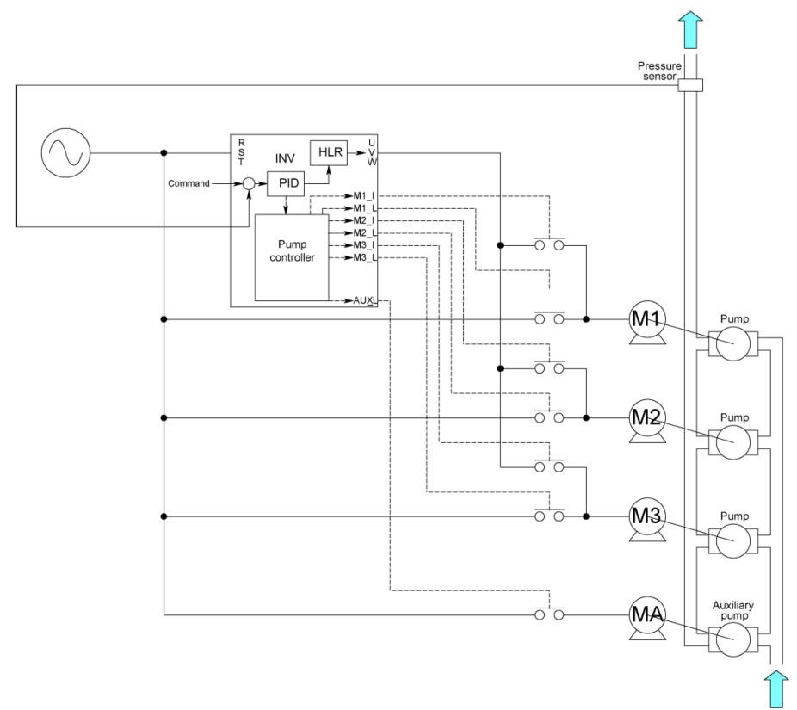
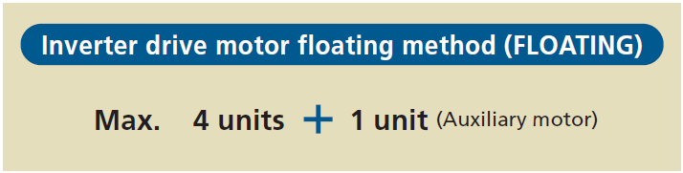
Optimise Functions
Cascade Control (Floating)
The system for this method is configured by combining the
motors that can be switched between inverter drive and
commercial drive (M1 to M3).
The motors are driven by the inverter with variable speed
control at start. When the desired discharge flow rate cannot
be achieved with the first motor, operations Floating -1 or
Floating-2 can be selected.
Variable
DOL
DOL
Variable
Variable
3
A single FRENIC-eHVAC drives a maximum of 3 pump motors.

Slide 20

Optimise Functions
Password function
- Possible to hide the display of data or prevent setting changes caused by unintended control
(possible to set in two levels).
Password 1 - Limits to change or display in function code:
0: All function codes are disclosed, but the change is not allowed.
1: Only the function code for quick setup can be disclosed/changed.
2: Only the function code for customize logic setting is not disclosed/not changed.
Password 2 (Read/write disable protection)
FAP- WG-eHVAC-Jan-2016
Notes:
1) Lock your inverter with password!

Slide 21







Communications Protocol
Standard support (On Board):
- RS485, Modbus RTU, BACnet MS/TP
Option support (Optional Card):
- Profibus DP, DeviceNet, Lonworks, CC-Link
FAP- WG-eHVAC-Jan-2016
Notes:
1) Lock your inverter with password!

Slide 22
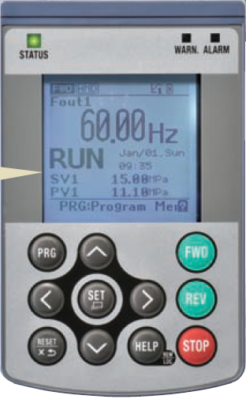
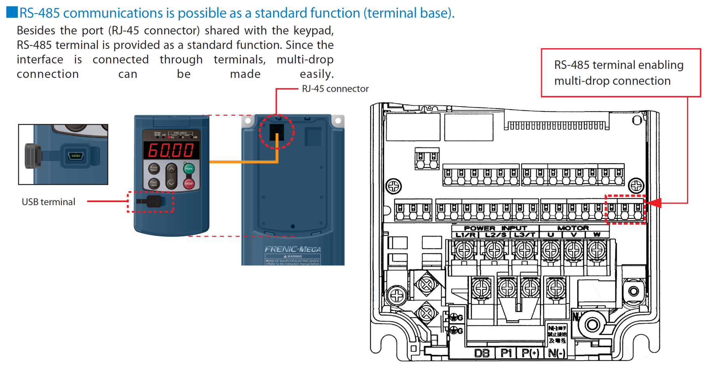

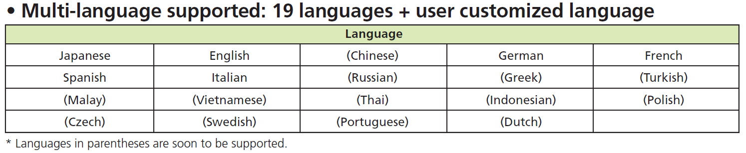
Optional Functions
Optional Multi-Function Keypad (External mount type)
- A multi-function keypad with support for 19 languages is available as an option to realize worldwide deployment.
TP-A1-E2C Multi function keypad
(Multi-language supported)
TP-E1U (with Mini B USB)
(Enable communication with
FRENIC-Loader software)
FAP- WG-eHVAC-Jan-2016
Notes:
1) Lock your inverter with password!

Slide 23




STANDARD
Standard and certifications
Safety Standard: IEC/EN 61800-5-1
Enclosure: IEC60529
EMC Directives: EN 61800-3-2 2nd / Category C2/C3
IEC/EN 61326-3-1
European Standard: CE
UL Standards: UL
FAP- WG-eHVAC-Jan-2016

Slide 24
Simply Easy!
FAP- WG-eHVAC-Jan-2016

Slide 25
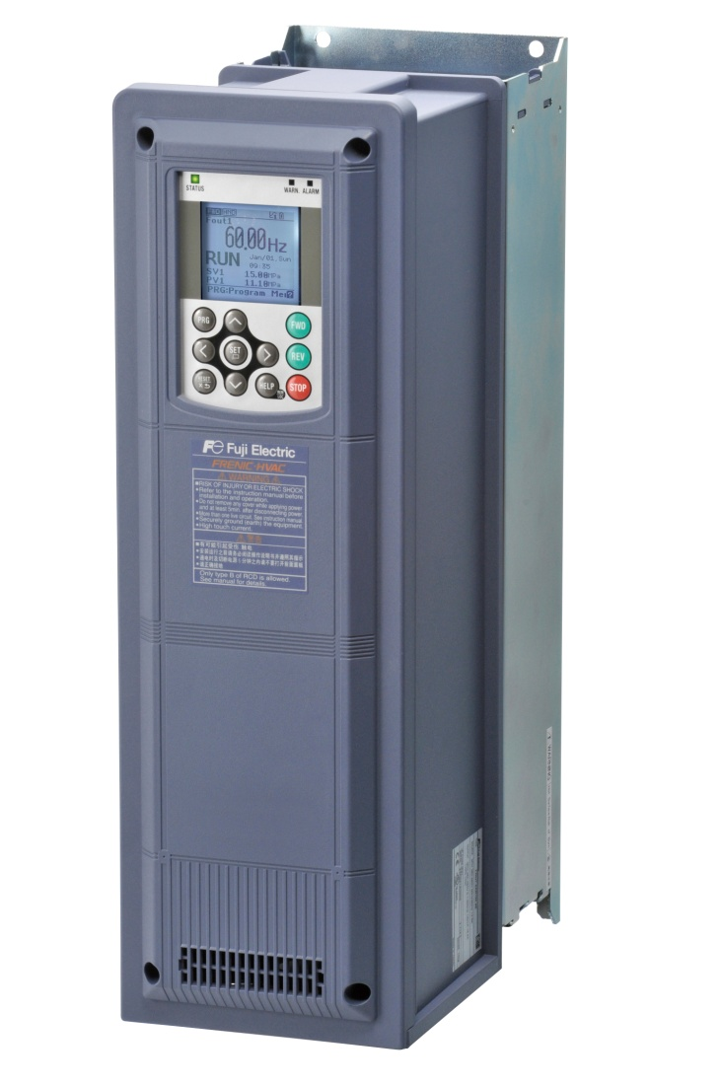

Advance Line
Multi functionality
Economy Line
Simplicity
FAP- WG-eHVAC-Jan-2016

Slide 26



At Fuji Electric
we believe we can do our part in energy conservation and help
reducing impact to the mother earth by using environmental friendly component for a better future.
High quality products through a quality assurance system that conforms to the ISO9001 Standard
FAP- WG-eHVAC-Jan-2016

Slide 27

www.fujielectric.com
Thank you
FAP- WG-eHVAC-Jan-2016

